Slide 1

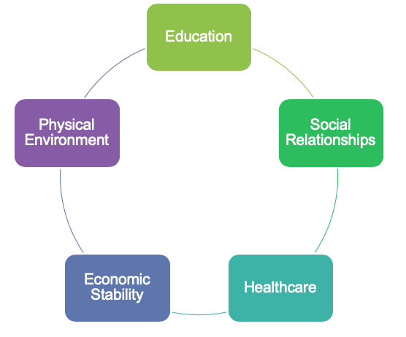

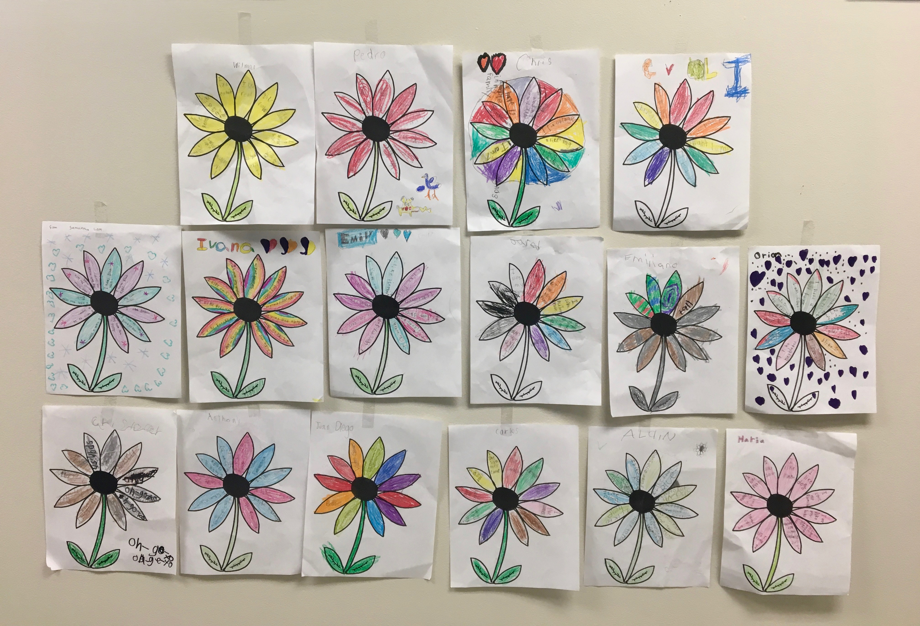
Community Education: Mental Health and Immunizations
Rachael D. Crenshaw
Urban Health Project 2019, University of Cincinnati College of Medicine
About Su Casa
Su Casa Hispanic Center is a non-profit organization run under the larger umbrella of Catholic Charities in Cincinnati. Su Casa is the largest provider of services to the Hispanic/Latinx community in Southwestern Ohio. Many of the clients that Su Casa serves are immigrants from Latin countries, with the most common countries of origin being Guatemala and Mexico. However, Su Casa also serves many members of the Hispanic/Latinx community that were born in the United States.
Services Provided
Su Casa provides a range of services to the Hispanic/Latinx community of greater Cincinnati in order to help their clients manage some of the common stressors that face this population such as poverty, lack of access to healthcare, and immigration struggles. This wide range of services includes, but is not limited to:
Legal immigration services
Case management for
unaccompanied children
Vacaciones Útiles Summer
Camp
English tutoring
Employment assistance
Mental Health services
Financial assistance
UHP Internship
During my part-time summer internship at Su Casa, my main responsibility was working at the Vacaciones Útiles Summer Camp. Vacaciones Útiles is an 8-week, educational summer program for kids ages 3-8 years old in the Hispanic/Latinx community. I specifically worked with the Kindergarten class during the summer.
Beyond working in the classroom at Vacaciones Útiles, I wanted to create an educational program that could be utilized by Su Casa. In my first meeting with the directors of Vacaciones Útiles, we brainstormed many topics in which I could offer medical knowledge. The directors felt the two topics that clients served by Su Casa would benefit from learning more about were mental health and immunizations. It was decided that I would create a mental health presentation, for both the kids attending Vacaciones Útiles and their parents. Additionally, I would create an immunization presentation for the parents. Both presentations would be available in Spanish and English and would also include community resources available to the Hispanic/Latinx population.
Mental Health: A Topic Worth Discussing
Although rates of depression among the Hispanic/Latinx community have been reported as high as 30%, ^{[2]} statistics show that only 1 in 10 ^{[1]} will seek mental health care. Mental health remains a highly stigmatized topic within this community that is not often discussed. The Hispanic/Latinx population, whether born in the United States or not, faces many barriers in each of the five social determinants of health.
It is well known that one’s mental health can have an important impact, positive or negative, on each social determinant of health. Therefore, by educating about the topic of mental health/mental illness among the Hispanic/Latinx community, and by connecting this community to mental health resources within the greater Cincinnati area, we can help to breakdown two main barriers to adequate mental health care: social stigma and lack of access to care.
Mental Health Education For the Kids
The highest rates of mental illness in the Hispanic/Latinx community is among those 17 years old and younger, ^{[2]} supporting the idea that mental health education needs to start young. I had two teaching days with the kids at Vacaciones Útiles in which I taught about self-esteem and stress management.
Self-esteem
During the first teaching day, the topic of mental health was introduced, as well as the importance of a positive self-esteem. The kids discussed what they liked about themselves and ways in which they were unique. Then, each child was given a blank flower to color however they wanted. The flowers were displayed outside of each classroom to remind the kids that although each flower was different, they were all beautiful.
Stress management
On the second teaching day, the kids discussed ways in which they feel stress such as frustration at school or conflict at home. Then, we practiced three ways to manage stress:
Yoga
Meditation
Exercise
Mental Health Education for the Parents
Initial survey
In order to ensure the mental health program would be relevant and educational to the Hispanic/Latinx community served by Su Casa, a short survey, available in English and Spanish, was given to parents of kids participating in Vacaciones Útiles at the beginning of the summer. The survey included many different topics of mental health and mental illness including safety in the home, substance abuse, depression, suicide prevention, and access to mental health services. There was also a space where parents could write in a topic of their choice. Parents were asked to indicate whether they would like to learn more about each topic by circling “YES” or “NO”. Results of the survey showed that substance abuse and safety in the home were the two highest scoring topics.
Presentation
Vacaciones Útiles offers two optional parent presentations each week of camp. I was given one of these presentation slots to educate on mental health. Many topics concerning mental health were going to be covered in the presentation, with a specific focus on the topic of substance abuse (alcohol) and safety in the home (trauma, gun safety, and suicide).
In order to measure the educational efficacy of the presentation, a pre- and post-survey were going to be given before and after the presentation, respectively. The results obtained with the pre- and post-survey would then be used to ensure the educational efficacy of the presentation and to make any necessary edits to increase the educational value.
Unforeseen barriers
Despite two attempts to present the mental health information to the parents at Vacaciones Útiles, the mental health presentation was unable to be given. Due to this, no data on the efficacy of the presentation was obtained.
Immunization Education
Education on immunizations and the importance of receiving immunizations is something that is lacking among the population served by Su Casa. The reason behind this lack of education is likely due to the fact that the majority of the clients that Su Casa serves are immigrants from Latin countries such as Guatemala and Mexico that do not have strict vaccination laws, and the presence of a language barrier that often prevents access to a proper healthcare education.
My immunization presentation covered topics such as an explanation of vaccinations and how they work to provide immunity from communicable disease, the history of vaccinations in the United States and consequences of anti-vaccination movements with recent outbreaks of disease. I also included many resources such as a vaccination schedule in Spanish, resources available in the community, and special vaccine considerations, such as the importance of women receiving a Tdap booster vaccine in the third trimester of each pregnancy.
As with the mental health presentation, the immunization presentation was unable to be given.
Future Directions
Although the information on mental health and immunizations was unable to be presented to the parents at Vacaciones Útiles, this information will still be made available to Su Casa and all the clients they serve. I am also currently working on a Quick Facts sheet for both mental health and immunizations that can be given to all the parents on the last day of the summer camp.
It could also be advantageous to share the mental health presentation with counselors within the public school system that Su Casa works with frequently.
Special Thanks
My sincerest thanks to Su Casa Hispanic Center for allowing me to intern at Vacaiones Útiles this summer. I specifically want to thank Karri O’Hara and José Nine for being so open-minded and allowing me the opportunity to educate on such important topics. Lastly, I would like to thank the Urban Health Project for connecting me with invaluable community service experience, and the co-directors Isaiah Noel and Namratha Kolur for all of their hard work to make UHP the best it can be.
Resources
[1]Latino Mental Health. National Alliance on Mental Health. https://www.nami.org/find- support/diverse-communities/latino-mental-health. Accessed 24 July 2019.
[2]Adhikari, S, Lewis, A. Mental Health, Suicidal Ideation, and Opioid Use Disorders among Hispanic and Latinos in Ohio. Columbus, OH: Ohio Department of Mental Health and Addiction Services & Ohio Commission on Hispanic/Latino Affairs. 2018.
Substance Abuse
Safety in the Home

